Slide 1

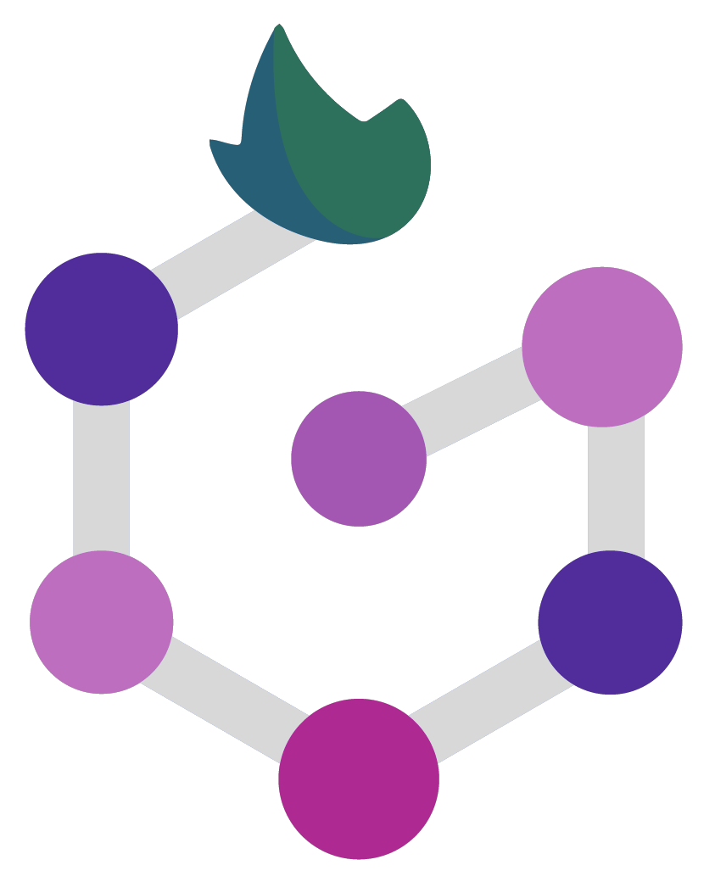

Basic Nextflow syntax and commands
Santiago Radío

Slide 2
Channels

Slide 3
Channels
Channels are a core concept in Nextflow, representing streams of data flowing through a pipeline, and are similar to UNIX pipes.
Data is processed by each process in the pipeline, taking data from input channels, processing it, and then writing results to output channels which become the input for the next process.
Channels are implemented as lazy collections, which enables Nextflow to optimize pipeline execution by minimizing the amount of data loaded into memory at any given time, ensuring scalability and parallel processing.

Slide 4

Queue Channels
The most common of the channels are the Queue channel.
A queue channel is an asynchronous unidirectional FIFO queue that connects two processes or operators.

Slide 5
Queue Channels
A queue channel is an asynchronous unidirectional FIFO queue that connects two processes or operators.
Let's break down what each of these terms mean:
- Asynchronous: This means that operations on the queue channel are non-blocking. In other words, a process that is producing data to the queue channel can continue running and producing data while a process that is consuming data from the queue channel is running.
- Unidirectional: This means that data flows in one direction from a producer to a consumer. In other words, a process can only write data to the queue channel, and another process can only read data from the queue channel.
- FIFO: This means that the data in the queue channel is guaranteed to be delivered in the same order as it is produced. First In, First Out. In other words, the first item produced is the first item consumed, and so on.

Slide 6
Queue Channels
ch = Channel.of(1,2,3)
println(ch)
ch.view()
Channel1.nf
This code creates a new channel ch using the Channel.of factory method, which initializes the channel with a sequence of values 1, 2, and 3.
The println statement outputs the ch object, which will show you a brief description of the channel object.
The view() method is then called on the channel object, which returns a new channel object that is a view of the original channel. The view is a representation of the channel's data that allows you to manipulate and transform the data without modifying the original channel.

Slide 7
Value Channels
The other type of channel is the Value channel.
A value channel in Nextflow is a channel that is bound to a single value, and can be read unlimited times without consuming its contents. This means that a value channel behaves differently from a queue channel, which can only be read once and then is consumed by the consuming process.
Value channels are useful for passing parameters or flags between processes, or for representing scalar values such as numbers or strings. They are created using the value factory method or by operators that return a single value, such as first, last, collect, count, min, max, reduce, and sum.

Slide 8


Value Channels
The other type of channel is the Value channel.
A value channel in Nextflow is a channel that is bound to a single value, and can be read unlimited times without consuming its contents. This means that a value channel behaves differently from a queue channel, which can only be read once and then is consumed by the consuming process.
They are created using the value factory method or by operators that return a single value, such as first, last, collect, count, min, max, reduce, and sum.
Queue channel
Value channel
Channel2

Slide 9

Channel factories
How does Nextflow enable the creation and manipulation of channels?

Slide 10
Channel factories
Channel factories are methods that can be used to create new channels with specific properties and values. Channel factories are a powerful tool for creating, manipulating, and combining channels in a pipeline, and can help you to optimize performance and efficiency when working with large amounts of data.

Slide 11
Channel factories
Channel factories are methods that can be used to create new channels with specific properties and values. Channel factories are a powerful tool for creating, manipulating, and combining channels in a pipeline, and can help you to optimize performance and efficiency when working with large amounts of data.
Channel.value and Channel.of are channel factory method.
Other methods:
fromList()
fromPath()
fromFilePairs()
Channel3.nf

Slide 12
Channel factories
fromList()
The method Channel.fromList creates a channel emitting the elements provided by a list object specified as an argument. The main difference between Channel.of and Channel.fromList, is that Channel.of accepts a variable number of arguments, while Channel.fromList accepts a list as input.
Channel3.nf

Slide 13
Channel factories
fromList()
The method Channel.fromList creates a channel emitting the elements provided by a list object specified as an argument. The main difference between Channel.of and Channel.fromList, is that Channel.of accepts a variable number of arguments, while Channel.fromList accepts a list as input.
fromPath()
The fromPath factory method creates a queue channel emitting one or more files matching the specified glob pattern.

Slide 14
Channel factories
2. fromPath()
The fromPath factory method creates a queue channel emitting one or more files matching the specified glob pattern.
glob: When set to true, special characters (*, ?, [], and {}) are interpreted as wildcards for globbing patterns, otherwise they are treated as normal characters. Default value is true.
type: Determines the type of path that should be returned, it can be "file", "dir" or "any". Default value is "file".
hidden: When set to true, includes hidden files in the resulting paths. Default value is false.
maxDepth: Sets the maximum number of directory levels to visit during directory tree traversal. Default value is no limit.
followLinks: When set to true, symbolic links are followed during directory tree traversal. Default value is true.
relative: When set to true, return paths are relative to the top-most common directory. Default value is false.
checkIfExists: When set to true, throws an exception when the specified path does not exist in the file system. Default value is false.

Slide 15
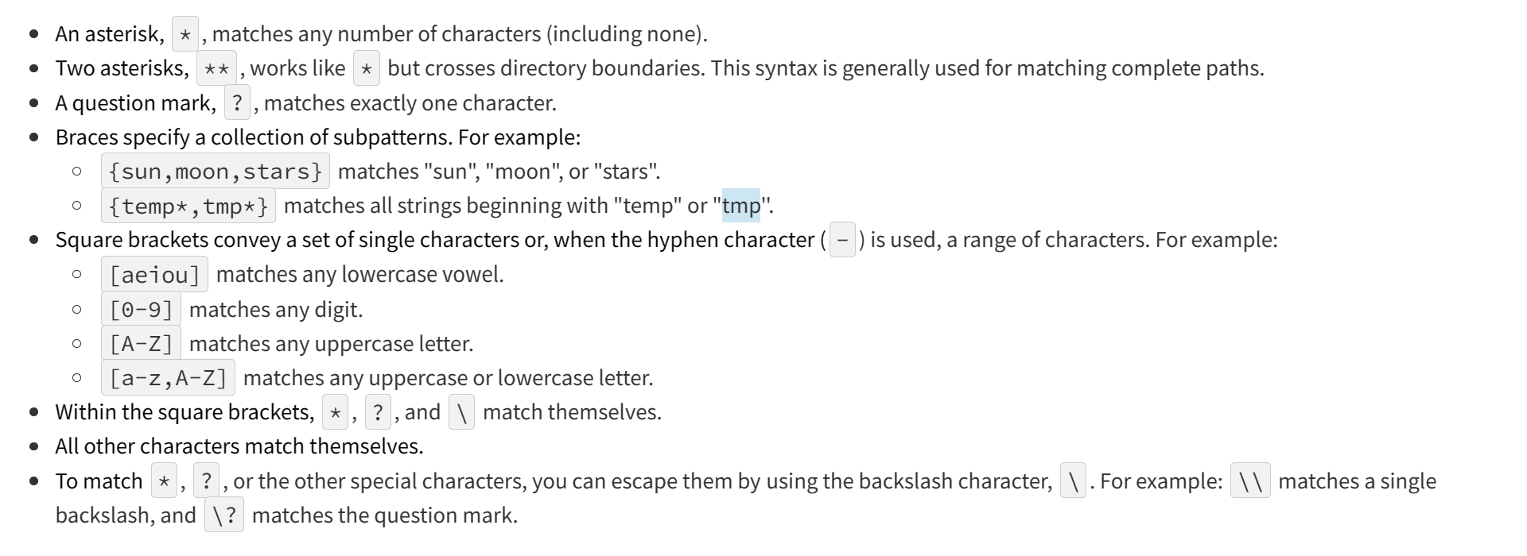
What Is a Glob?
A glob pattern is specified as a string and is matched against other strings

Slide 16
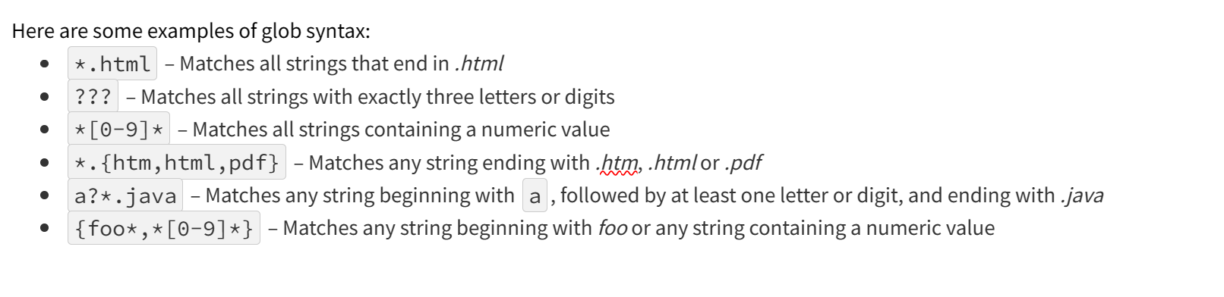
What Is a Glob?
A glob pattern is specified as a string and is matched against other strings
Channel4.nf

Slide 17
Channel factories
fromFilePairs()
The fromFilePairs method creates a channel emitting the file pairs matching a glob pattern provided by the user. The matching files are emitted as tuples, in which the first element is the grouping key of the matching pair and the second element is the list of files (sorted in lexicographical order).
type: Type of paths returned, either file, dir or any (default: file)
hidden: When true includes hidden files in the resulting paths (default: false)
maxDepth: Maximum number of directory levels to visit (default: no limit)
followLinks: When true symbolic links are followed during directory tree traversal, otherwise they are managed as files (default: true)
size: Defines the number of files each emitted item is expected to hold (default: 2). Set to -1 for any.
flat: When true the matching files are produced as sole elements in the emitted tuples (default: false).
checkIfExists: When true, it throws an exception of the specified path that does not exist in the file system (default: false)
Channel5.nf

Slide 18
Channel and text
splitText():
This method splits the input data into individual lines. By default, it uses the newline character as the delimiter, but you can specify a different delimiter if needed.
subscribe():
The subscribe method allows you to execute a user defined function each time a new value is emitted by the source channel.
Channel6.nf

Slide 19
Closure
In programming, a closure is a block of code that can be passed around as a value, just like a variable or a function. Closures are often used to define behavior that can be executed at a later time, or to encapsulate a set of operations as a single unit.
In Nextflow, closures are commonly used to define what should happen to each item in a channel as it becomes available
A closure in Nextflow DSL2 is defined using the following syntax:
{ arguments -> body }
Channel7.nf

Slide 20
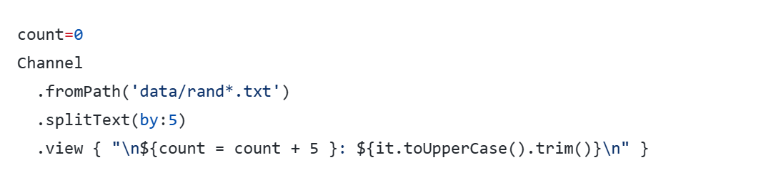

Closure
1 - What trim does?
The trim method is a built-in function in Groovy (the language used by Nextflow DSL2). It is used to remove whitespace (spaces, tabs, newlines, etc.) from the beginning and end of a string.
For example, if we have a string that looks like this:
" Hello, world! \n"
Calling trim() on this string would remove the leading and trailing spaces and newlines, resulting in:
"Hello, world!"

Slide 21
Closure
2 - How can I increment the value of count
To change the incremental value of count in the closure, you can simply add any value you want to count instead of using the ++ operator (plus 1). For example, to increment count by 5 each time, you the example above.
```
count = 0
Channel
.fromPath('data/rand*.txt')
.splitText()
.view { "${count++}: ${it.toUpperCase().trim()}" }
```

Slide 22
Closure
3 - it is an standard? I can put another value?
The variable it is a standard variable name that is commonly used in Groovy to refer to a single value or object that is being processed. In the context of Nextflow, the it variable is used to represent each item in a channel as it becomes available. When you apply a closure to a channel operation like view, it refers to the item in the channel that the closure is being applied to.
While it is a convention that is widely used and understood, you are free to use a different variable name if you prefer.
An example of change:
```
def count = 0
Channel
.fromPath('data/rand*.txt')
.splitText()
.view { row -> "${count += 15}: ${row.toUpperCase().trim()}" }
```

Slide 23
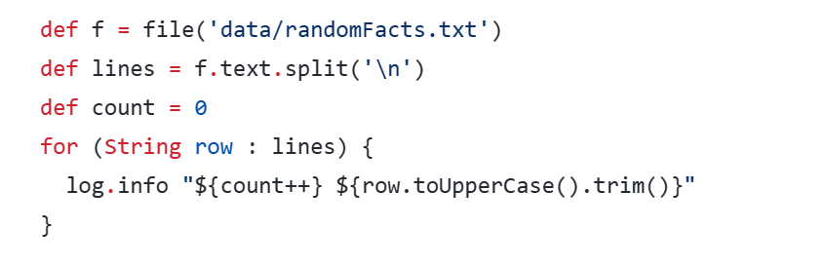
Dynamic typing
4 - Can I use things outside channels?
In Groovy, the def keyword is used to declare a variable without specifying its type. This is known as dynamic typing, and it allows you to create variables without having to worry about the specific data type they will contain.
Using def can make your code more concise and easier to read, since you don't have to write out the full type declaration every time you create a variable. It can also make your code more flexible, since you can change the data type of a variable at runtime if needed.
In the examples I provided, I used def to declare variables like f, lines, and count. Since the type of these variables is determined by their value (e.g. f is a file object, lines is an array of strings), we don't need to explicitly specify their type using a more specific keyword like String or File.
However, it's important to note that dynamic typing can also make your code more error-prone, since it's easier to accidentally assign a value of the wrong type to a variable. In some cases, it may be better to use a more specific type declaration to ensure that your code is as robust as possible.

Slide 24

Comma separate values
The splitCsv operator is used to parse text data that is in Comma-Separated Value (CSV) format.
This operator has the following options:
by: the number of rows in each chunk.
sep: the character used to separate the values (default: ,).
quote: values may be quoted by single or double quote characters.
header: when true the first line is used as columns names.
charset: parse the content by using the specified charset, e.g. UTF-8.
strip: removes leading and trailing blanks from values (default: false).
skip: number of lines since the file beginning to ignore when parsing the CSV content.
limit: limits the number of retrieved records for each file to the specified value.
decompress: when true, decompresses the content using the GZIP format before processing it
Channel8.nf

Slide 25
Processes

Slide 26
Process
In Nextflow, a process is a fundamental building block that executes a user script or command. A process is defined using the process keyword followed by the process name, and then the process body enclosed in curly brackets.
A process may include optional definition blocks, including directives, input, output, when, and the process script.
1. Directives are initial declarations that define optional settings
2. Input defines the expected input file(s) and the channel from where to find them
3. Output defines the expected output file(s) and the channel to send the data to
4. When is an optional clause statement to allow conditional processes
5. Script is a string statement that defines the command to be executed by the process

Slide 27
Process
In Nextflow, a process is a fundamental building block that executes a user script or command.
A process may include optional definition blocks:
1. Directives are initial declarations that define optional settings
2. Input defines the expected input file(s) and the channel from where to find them
3. Output defines the expected output file(s) and the channel to send the data to
4. When is an optional clause statement to allow conditional processes
5. Script is a string statement that defines the command to be executed by the process
process < name > {
[ directives ]
input:
< process inputs >
output:
< process outputs >
when:
< condition >
[script|shell|exec]:
"""
< user script to be executed >
"""
}

Slide 28
Scripts
The script block is where you define the script that will be executed by the process.
Script string is executed as a Bash script in the host environment, so it can be any command or script that you would normally execute on the command line or in a Bash script. However, any other scripting language can be used by simply starting the script with the corresponding Shebang :
#!/usr/bin/env python

Slide 29
Scripts
If you need to use a system environment variable in your script, you can define the script block with single quotes, and the variable will be treated as a literal string. For example:
process printPath {
script:
'''
echo "The path is: $PATH"
'''
}
Alternatively, you can define your script with double-quotes and escape the system environment variables by prefixing them with a back-slash character. For example:
process runBlast {
script:
"blastp -db \$DB -query ${params.query} -outfmt 6 > ${blastOutput}"
}

Slide 30
Scripts
Lastly, you can use the shell block definition to allow a script to contain both Bash and Nextflow variables without having to escape the first. For example:
process runBlast {
shell:
"""
blastp -db $DB -query !{params.query} -outfmt 6 > !{blastOutput}
"""
}
Process1.nf

Slide 31
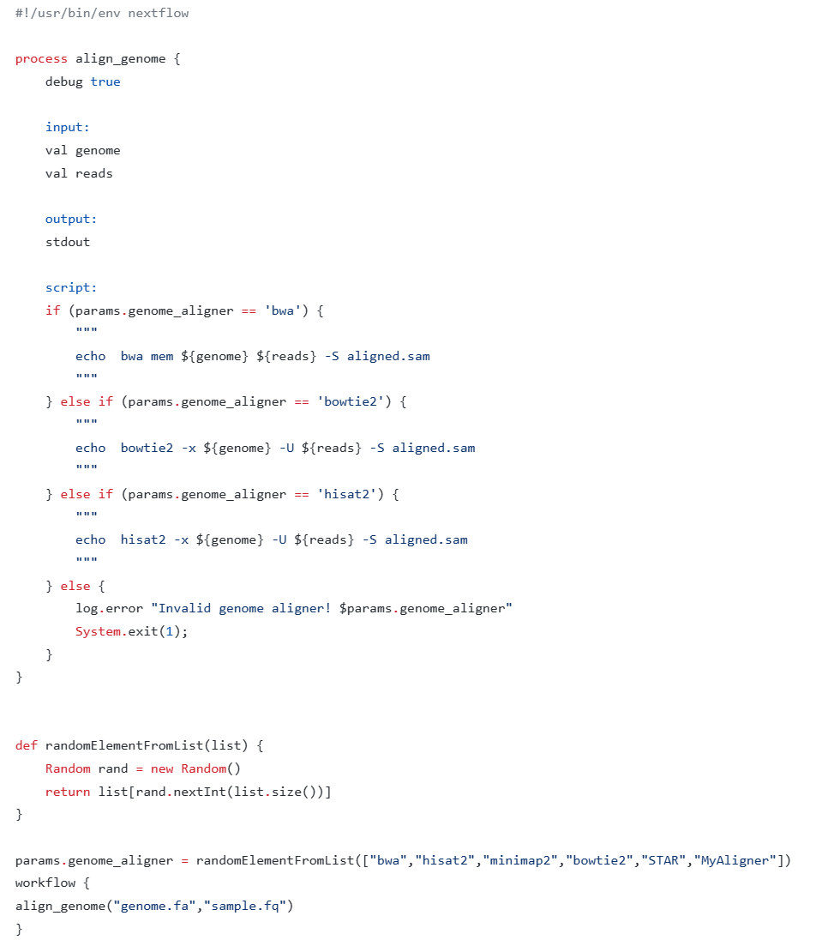
Scripts Conditionals
The process script can also be defined in a completely dynamic manner using an if statement or any other expression for evaluating a string value.
Process2.nf

Slide 32
THANK YOU

